Slide 1
Chemical Bonding

Slide 2

Types of Chemical Bonding
Ionic
Covalent
Metallic

Slide 3
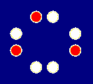

Ions
Ions form when atoms lose or gain electrons.
Atoms with few valence electrons tend to lose them to form cations.
Atoms with many valence electrons tend to gain electrons to form anions
Na
Mg
N
O
F
Ne
Na⁺
Mg²⁺
N³⁻
O²⁻
F⁻
Cations
Anions

Slide 4
Ionic Bonding Example: Na and Cl
In ionic bonding one atom has a stronger attraction for electrons than the other, and “steals” an electron from a second atom
e–
1)
2)
Na
Cl
3)
Na⁺
Cl–

Slide 5
Ionic Bonding
Ionic bonds result from the attractions between positive and negative ions.
Ionic bonding involves 3 aspects:
  loss of an electron(s) by one element.
  gain of electron(s) by a second element.
  attraction between positive and negative ions.

Slide 6
Stable Octet Rule
Atoms tend to either gain or lose electrons in their highest energy level to form ions
Atoms prefer having 8 electrons in their highest energy level
Examples
Na atom 1s² 2s² 2p⁶ 3s¹ One electron extra
Cl atom 1s² 2s² 2p⁶ 3s² 3p⁵ One electron short of a stable octet
Na⁺ Ion 1s² 2s² 2p⁶ Stable octet
Cl⁻ Ion 1s² 2s² 2p⁶ 3s² 3p⁶ Stable octet
Positive ions attract negative ions forming ionic bonds.

Slide 7
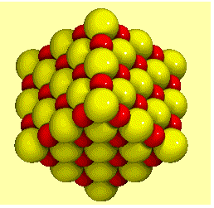
Ionic Bonding
Ionic substances are made of repeating arrays of positive and negative ions.
An ionic crystal lattice

Slide 8
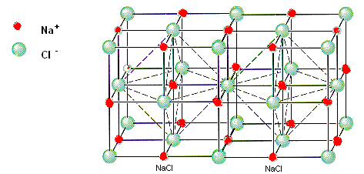
Ionic Bonding
The array is repeated over and over to form the crystal lattice.
Model of a
Sodium chloride
crystal
Each Na⁺ ion is surrounded by 6 other Cl⁻ ions. Each Cl⁻ ion is surroundedby 6 other Na⁺ ions

Slide 9
Ionic Bonding
The shape and form of the crystal lattice depend on several factors:
The size of the ions
        The charges of the ions
        The relative numbers of
        positive and negative ions

Slide 10
Ionic Bonding
The shape and form of the crystal lattice depend on several factors:
The size of the ions
The charges of the ions
The relative numbers of positive and negative ions

Slide 11
Strength of ionic Bonds
The strength of an ionic bond is determined by the charges of the ions and the distance between them.
The larger the charges and the smaller the ions the stronger the bonds will be
Bond strength then is proportional to
    Q1 x Q 2
    r²
    Where Q1 and Q2 represent ion charges and r is the sum of the ionic radii.

Slide 12

Characteristics of ionic bonds
Crystalline at room temperatures
Higher melting points and boiling points than covalent compounds
Conduct electrical current in molten or solution state but not in the solid state
Polar bonds
More soluble in polar solvents such as water
Water solutions of ionic compounds are
usually electrolytes.
That is they conduct electrical currents

Slide 13
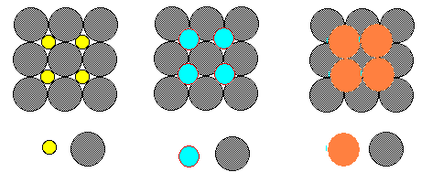
Ionic Bonding Structure
The crystal lattice pattern depends on the ion size and the relative ratio of positive and negative atoms

Slide 14
Covalent Bonds

Slide 15
Covalent Bonding
Covalent bonds form when atoms share electrons
Atoms that lack the necessary electrons to form a stable octet are most likely to form covalent bonds.
Covalent bonds are most likely to form between two nonmetals

Slide 16
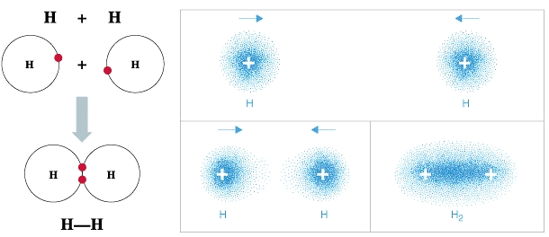
Covalent Bonding
A covalent bond exists where groups of atoms (or molecules) share 1 or more pairs of electrons.
When atoms share electrons, these shared electrons must be located in between the atoms. Therefore the atoms do not have spherical shapes. The angular relationship between bonds is largely a function of the number of electron pairs.

Slide 17
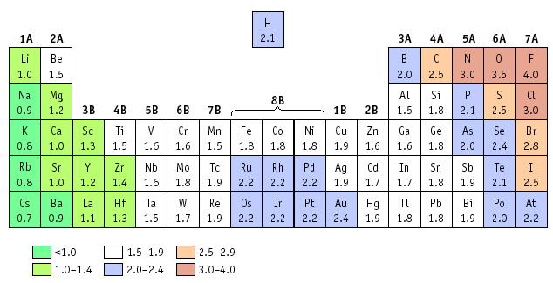
Electronegativities and Bond Type
The type of bond or degree of polarity can usually be calculated by finding the difference in electronegativity of the two atoms that form the bond.

Slide 18
The Rule of 1.7
Used to determine if a bond is ionic or covalent
Ionic and covalent are not separate things but differences in degree
Atoms that have electronegativity differences greater than 1.7 usually form ionic bonds. i.e NaCl
Atoms that have electronegativity differences less than 1.7 form polar covalent bonds. i.e H₂O
The smaller the electronegativity difference the less polar the bond will be.
If the difference is zero the bond is totally covalent. i.e. Cl₂.

Slide 19
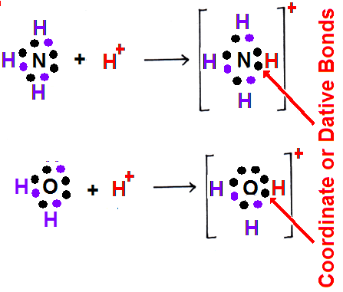
Coordinate Covalent Bonds
Coordinate covalent bonds occur when one atom donates both of the electrons that are shared between two atoms
Coordinate covalent
bonds are also called
Dative Bonds

Slide 20
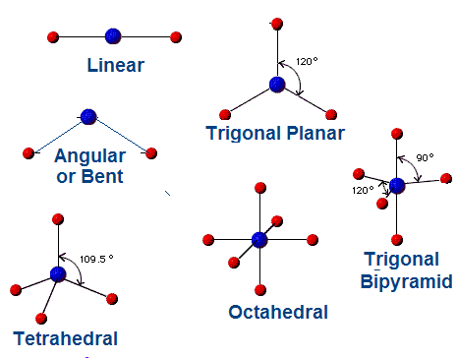
Polarity
Molecular Polarity depends on the relative electronegativities of the atoms in the molecule.
The shape of the molecule.
Common Molecular shapes
The shape of a molecule can be predicted from the
bonding pattern of
the atoms forming
the molecule or polyatomic ion.
The shape of a molecule can be predicted from the
bonding pattern of
the atoms forming
the molecule or polyatomic ion.

Slide 21
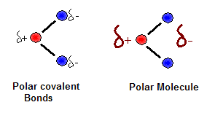
Polar Covalent Molecules
A polar covalent bond has an uneven distribution of charge due to an unequal sharing of bonding electrons.
In this case the molecule is also polar since the bonds in the molecule are arranged so that the charge is not symmetrically distributed

Slide 22
Polarity
Molecules that contain polar covalent bonds may or may not be polar molecules.
The polarity of a molecule is determined by measuring the dipole moment.
This depends on two factors:
  The degree of the overall separation of charge between the atoms in the bond
  The distance between the positive and negative poles

Slide 23
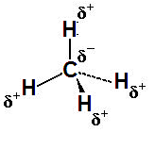
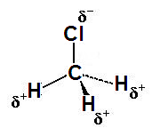
Polarity
If there are equal polar bonds that balance each other around the central atom, then the overall molecule will be NONPOLAR with no dipole moment, even though the bonds within the molecule may be polar.
- Polar bonds cancel
- There is no dipole moment
- Molecule is non-polar
- Polar bonds do not cancel
- There is a net dipole moment - The molecule is polar

Slide 24
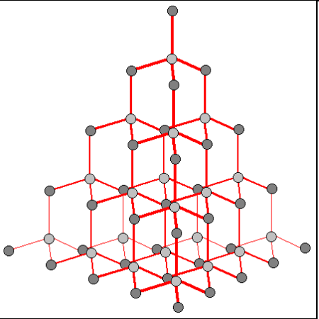
Covalent Network Solids
Network solids have repeating network of Covalent bonds that extends throughout the solid forming the equivalent of one enormous molecule.
Such solids are hard and rigid and have high melting points.
Diamond is the most well-known example of a network solid. It consists of repeating tetrahedrally bonded carbon atoms.
Network structure for diamond

Slide 25
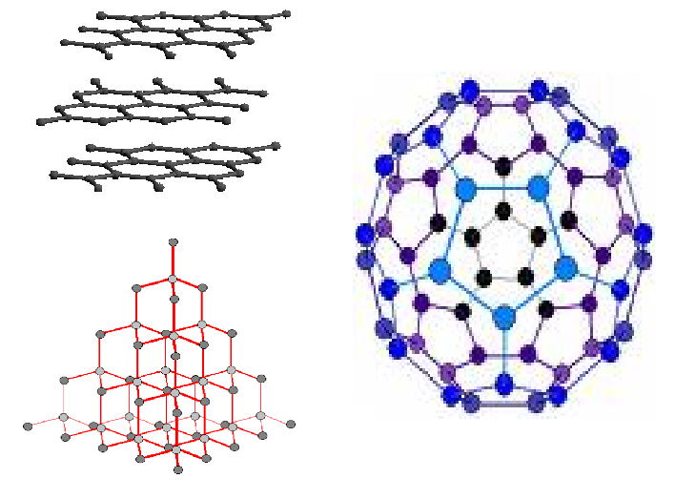
Allotropes
Carbon actually has several different molecular structures.
These very different chemical structures of the same element are known as allotropes.
Oxygen, sulfur, and phosphorous all have multiple molecular structures.
C₆₀
Graphite
Buckminster
Fullerene
Diamond

Slide 26
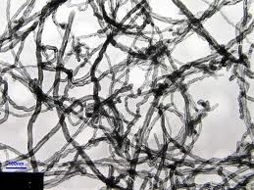
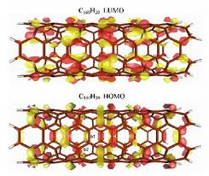
Carbon Nanotubes
Carbon nanotubes are allotropes of carbon that have a cylindrical nanostructure.
Nanotubes have been constructed with length-to-diameter ratio of up to 132,000,000 to 1
Carbon nanotubes are hexagonally shaped arrangements of carbon atoms that have been rolled into tubes.
These tiny straw-like cylinders of pure carbon are among the stiffest and strongest fibers known . They have useful electrical properties..

Slide 27
Metallic Bonding

Slide 28
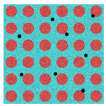
Metallic Bonding
Metallic Bonds are a special type of bonding that occurs only in metals
Characteristics of a Metallic Bond.
A metallic bond occurs in metals. A metal consists of positive ions surrounded by a “sea” of mobile electrons.
Good conductors of heat and electricity
Great strength
Malleable and Ductile
Luster
This diagram shows how metallic bonds might appear

Slide 29
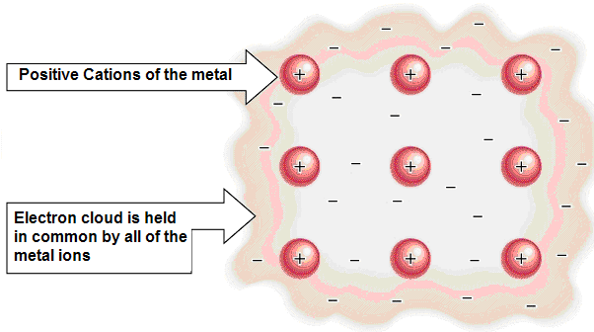
Metallic Bonding

Slide 30
Metallic Bonding
All the atoms in metallic bonds are alike. They all have diffuse electron densities. They are similar to the cations in ionic bonds.
Like the cations in ionic crystals, metallic atoms give up their valence electrons, but instead of giving the electrons to some other specific atom, they are redistributed to all atoms, and are shared by all.
The model is called "electron gas".
Eg. Na metal. 1s²2s²2p⁶3s¹. Each Na atom gives up its 3s¹ electrons. We end up with an array of positive ions in a sea of negatively
charged space.
The electron gas behaves like
the “glue” that holds the metal
structure together.

Slide 31
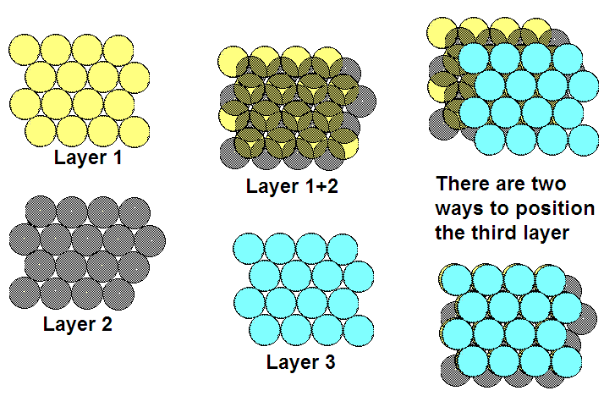
Close Packing Structures
←Offset
←Directly
above
There are two ways to position the third layer: Offset and directly above layer 1

Slide 32
Metallic Bond Characteristics
Properties of metals
  Metallic shiny luster.
  Malleable.
  Electrical conductivity.
  Easy tendency to form alloys.
  High density.
Alloys
  Because the atoms are considered to be positive spheres in a sea of electrons , any similar sized sphere can fit right in without too much trouble.
  Even dissimilar sized (i.e. even smaller H atoms) can fit into the spaces between atoms.

Slide 33
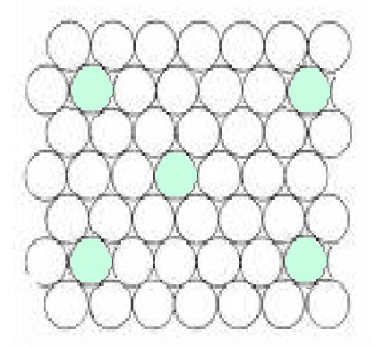
Alloys
Small amounts of a another element added to a metal can change its overall properties.
For example, adding a small amount of carbon to iron, will significantly increase its hardness and strength forming steel.

Slide 34
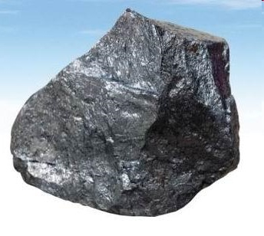
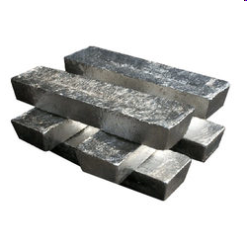

Semimetals
Silicon
Magnesium
The electrons in semimetals are much less mobile than in metals, hence they are semiconductors

Slide 35
Comparison of Types of Bonding
Ionic
Covalent
Metallic
Formation
Anion & cation Transferred electrons
Shared electrons
Cations in a sea of mobile valence electrons
Source
Metal + nonmetal
Two nonmetals
Metals only
Melting point
Relatively high
Relatively low
Generally high
Solubility
Dissolve best in water and polar solutions
Dissolve best in non-polar solvents
Generally do not dissolve
Conductivity
Water solutions conduct electricity
Solutions conduct electricity poorly or not at all
Conduct electricity well
Other properties
Strong crystal lattice
Weak crystal structure
Metallic properties; luster, malleability etc.

Slide 36
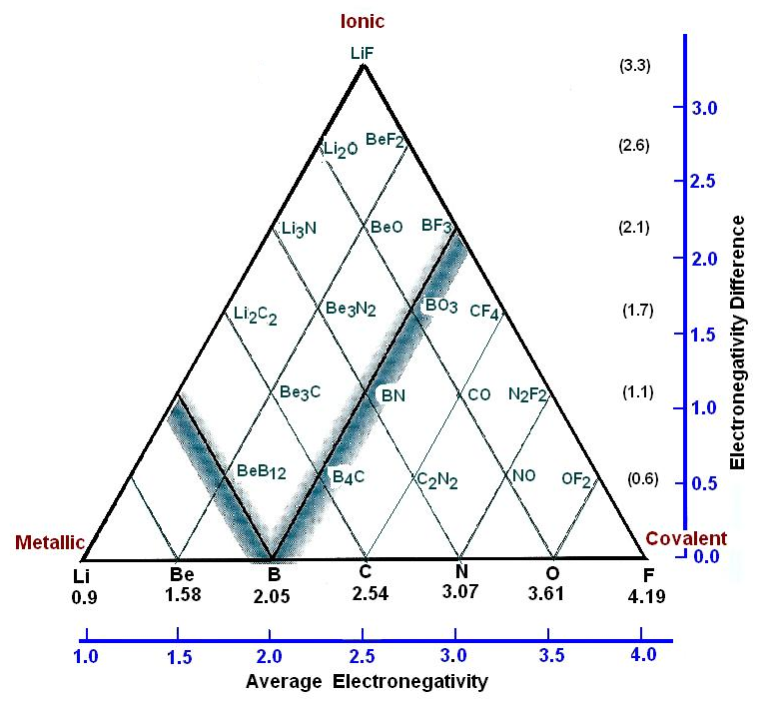
Bonding Types Are Continuous
There are no clear boundaries between the three types of bonding.
Chemical bonding may be thought of as a triangle.
Each vertex represents one of the three types of chemical bonds.
There are all degrees of bonding types between these extremes.

Slide 37
The End

